Slide 1
May 1 - 5 , 2023
Math: Module 7: Geometry
Monday: L. 18& 19 – Area and Perimeter; factors of multiplication
Tuesday: L 120-21 Construct rectangles with given perimeter and determine areas
Wednesday: L. 23 Perimeter word problems
Thursday/Friday: L 24 – 27 Construct a robot with specific perimeter measurements
Timed Multiplication Tests
April 14th – multiply by 7s
April 21st – multiply by 8s
May 5 – multiply by 9s
May 12th – multiply by 11s
May 18th – mult. by 12s
Important Dates!
May 1-5th – Teacher Appreciation Week
May 12th – Field Trip to the Zoo
May 19th – Field Day
May 17-18 AR Store
May 25th – 5th Grade Promotion
May 26th – Last Day of School!!
Math Homework:
will be passed out on Tuesday
Science Homework:
none
Devices: Students are EXPECTED to bring their device every day, CHARGED and ready to go.
UNIFORM REMINDER: Red, White, or Grey tops & Navy, Khaki, or Black bottoms. NO GREY PANTS

Slide 2
April 17 - 21 , 2023
Math:
TN Ready Review
Pease be here and on time every day. If your child comes in after we have started testing, they will have to wait in the office until we have a break. Then they will have to take the section they missed in the afternoon.
Timed Multiplication Tests
April 14th – multiply by 7s
April 21st – multiply by 8s
April 28th – multiply by 9s
May 5th – multiply by 11s
May 12th – multiply by 12s
Important Dates!
April 4th – Chick-fil-A
April 7th – No School – Good Friday
April 17-27 – TN Ready Testing
April 13th-14th – Auction Preview
April 19th-20th – Spring Auction
April 21st – SPRING FLING!!
Math Homework:
none
Science Homework:
none
Devices: Students are EXPECTED to bring their device every day, CHARGED and ready to go.
UNIFORM REMINDER: Red, White, or Grey tops & Navy, Khaki, or Black bottoms. NO GREY PANTS

Slide 3
April 1 0 – 1 4 , 2023
Math:
TN Ready Review
Pease be here and on time every day. If your child comes in after we have started testing, they will have to wait in the office until we have a break. Then they will have to take the section they missed in the afternoon.
Timed Multiplication Tests
April 14th – multiply by 7s
April 21st – multiply by 8s
April 28th – multiply by 9s
May 5th – multiply by 11s
May 12th – multiply by 12s
Important Dates!
April 4th – Chick-fil-A
April 7th – No School – Good Friday
April 17-27 – TN Ready Testing
April 13th-14th – Auction Preview
April 19th-20th – Spring Auction
April 21st – SPRING FLING!!
Math Homework:
none
Science Homework:
none
SPRING AUCTION: Be sure to check out the Spring Auction! Ms. Darnell’s and Mrs. Dollar’s class will have a VERY SPECIAL item up for grabs!!
Devices: Students are EXPECTED to bring their device every day, CHARGED and ready to go.

Slide 4
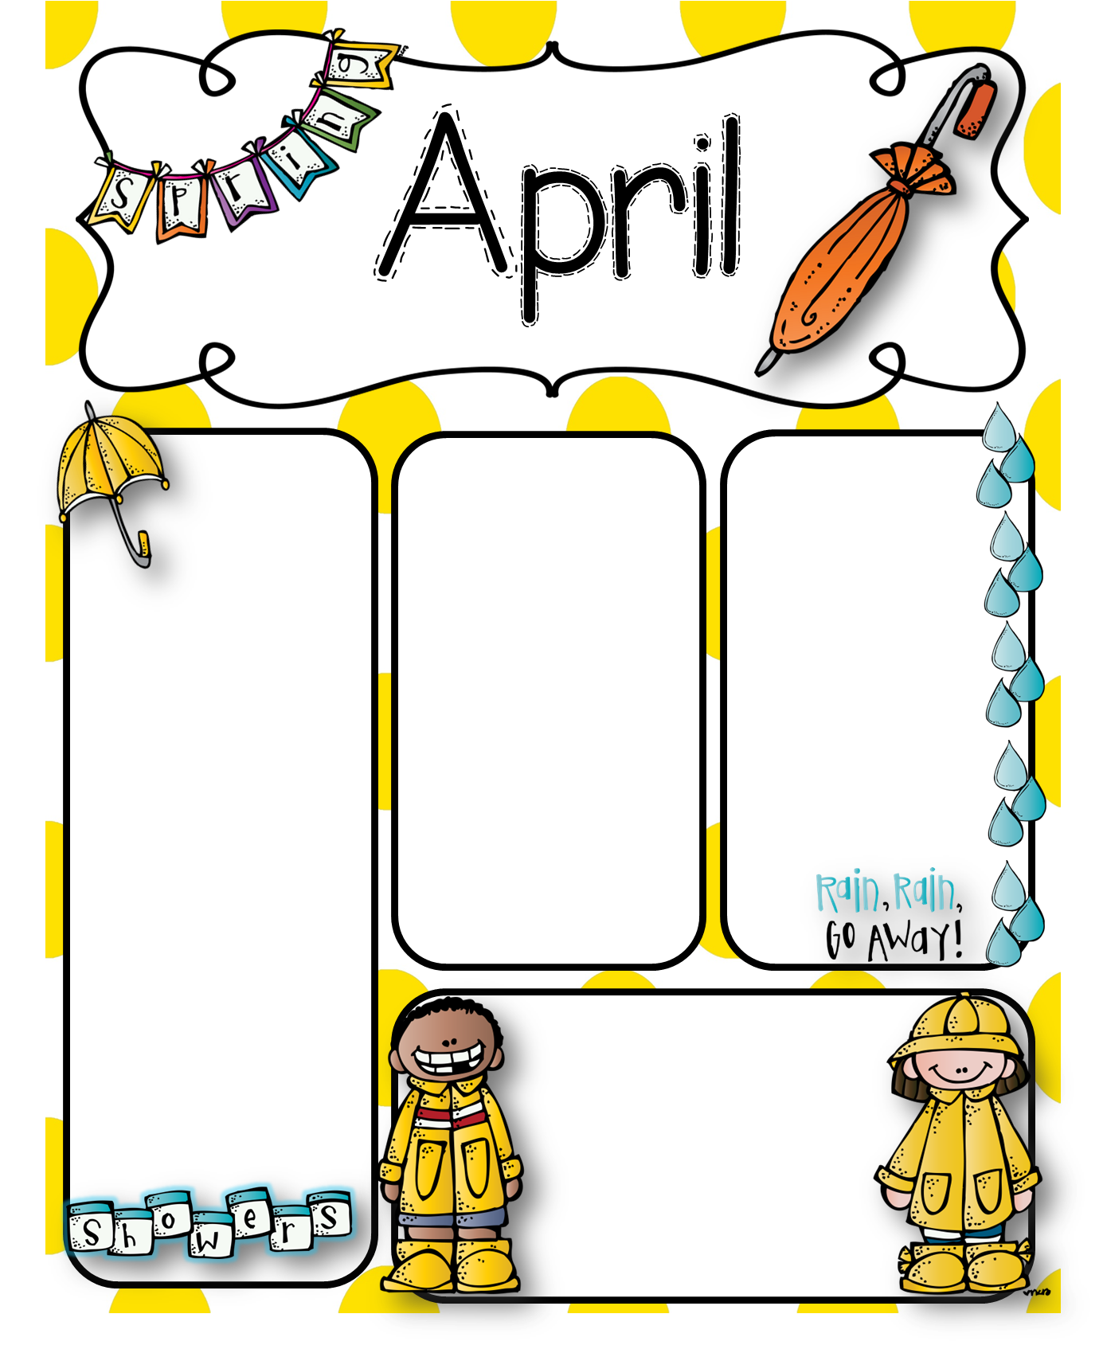
April 3-6 , 2023
Timed Multiplication Tests
April 14th – multiply by 7s
April 21st – multiply by 8s
April 28th – multiply by 9s
May 5th – multiply by 11s
May 12th – multiply by 12s
Important Dates!
April 4th – Chick-fil-A
April 7th – No School – Good Friday
April 17-27 – TN Ready Testing
April 13th-14th – Auction Preview
April 19th-20th – Spring Auction
April 21st – SPRING FLING!!
Math: Module 7: Geometry
Monday: L. 14 – Perimeter
Tuesday: L 15 – Perimeter & solving word problems
Wednesday: Mid-Module 7 Test
Thursday: L 17 – Solve Perimeter with unknown measurements
Math Homework: Module 7 Geometry Practice
Science Homework:
None: activities will be completed in class for homework.
Devices: Students are
EXPECTED to bring their device every day, CHARGED and
ready to go.

Slide 5
March 27 – 31 , 2023
Homework: Math Packet
Science: Legends of Learning Activity on Plants: Go through CLEVER > Canvas > Science > Legends of Learning
What else can you do at home? – iReady, Xtra Math, or Prodigy Math
Important Dates!
Boosterthon! Kick off Thursday, March 23rd
FUN FUN – Friday, March 31st
March 24th – Skate Night!!
March 28th Data Night
March 29th – Report Cards
March 31st – x6 timed facts
April 17-25 TCAP Testing
May 12: Field Trip to the ZOO! Please pay online and send in your child’s permission slip!
Math: Module 7: Geometry: Perimeter
Monday – Lesson 10:
Tuesday –Lesson 12:
Wed – Lesson 13 & 14:
Thursday – Lesson 15:
Friday – Lesson 17:
Uniform Reminder: Pants/Bottoms must be Navy, Khaki, or Black. Grey pants are not part of our uniform.
Devices: Students are EXPECTED to bring their device every day, CHARGED and ready to go.

Slide 6
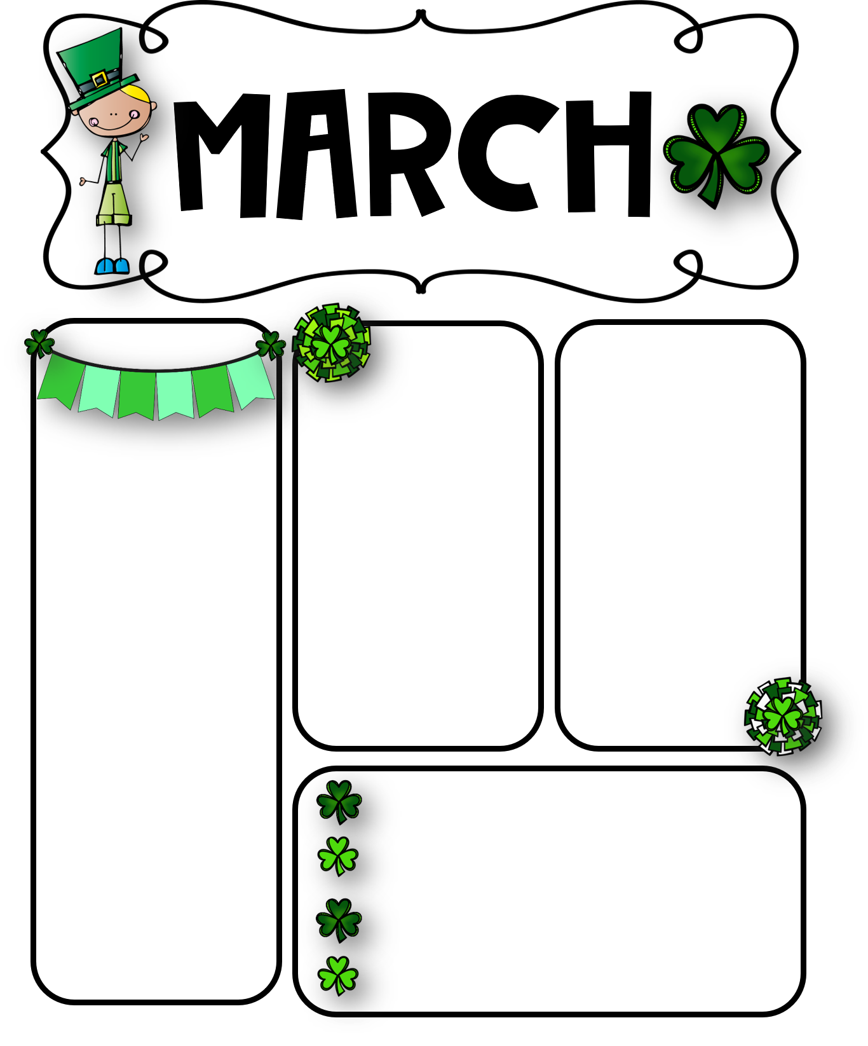
March 20 - 24 , 2023
Math: Module 7: Geometry: Perimeter
Monday – Lessons 1&2
Tuesday –Lesson 4 & 5
Wed – Lesson 6
Thursday – Lesson 7 & 8
Friday – Lesson 9
Homework: No Math or science homework!
Timed Math Test:
Friday, March 24 – x4
What else can you do at home? – iReady, Xtra Math, or Prodigy Math
Important Dates!
Boosterthon!
FUN RUN – Friday, March 31st
March 24th – x4 Timed Test
March 24th – Skate Night!!
March 28th - Data Night
March 29th – Report Cards
April 11th – iReady ELA Blitz *complete 15 lessons from March 11 – April 11th
April 17-25 TCAP Testing
May 12: Field Trip to the ZOO! Please pay online and send in your child’s permission slip!
Uniform Reminder: Pants/Bottoms must be Navy, Khaki, or Black. Grey pants are not part of our uniform.
Devices: Students are EXPECTED to bring their device every day, CHARGED and ready to go.

Slide 7
Feb. 27 – Mar. 3 , 2023
Math: Module 5: Fractions on a Number Line
Monday – Mock TCAP ELA Assessment
Tuesday Mock TCAP Math Assessment
Wednesday Mock TCAP Science Assessment: Lessons 23 & 24 Equivalent fractions on a number Line
Thursday – Lesson 26 Decompose whole number fractions greater than 1
Friday – Lesson 27
Important Dates!
Feb. 27-Mar. 3: BookFair
March 2: STEM Night 5:30 pm.
March 4: Grounds Beautification
March 6-8: Mastery Connect Assessments for 3rd Grade
March 10: iReady Math Blitz Celebration
March 13-17: Spring Break
March 23: Boosterthon Kick-off
March 24: Skate Night
March 31: Boosterthon Fun Run!
Math Homework: Fractions Packet
Science Homework: None
Uniform Reminder: Pants/Bottoms must be Navy, Khaki, or Black. Grey pants are not part of our uniform.
Devices: Students are EXPECTED to bring their device every day, CHARGED and ready to go.

Slide 8
Please scroll down for Spring Break Learning Academy information
Feb. 20-24, 2023
Math: Module 4: Fractions on a Number Line
Monday – Lesson 17 Fractions on a Number Line
Tuesday Lesson 18 Compare Fractions on a Number Line
Wednesday Lessons 21 & 22 Equivalent fractions on a number Line
Thursday – Lessons 23 & 24 Equivalent fractions on a number Line
Friday – Lesson 26 Decompose whole number fractions greater than 1
Homework –
Math –Unit 5 Fractions Packet
Science: Science Fair Projects in class!
We will have an EOM5 Math Test NEXT week!
This week, students
in 3-03 will have Ms. Darnell for
math and science in the morning, then switch to Mrs. Dollar for Social Studies then ELA after lunch.
Students 3-04 will have Mrs. Dollar for ELA and social studies, then switch to science and math with Ms. Darnell
Important Dates!
Feb. 21 & 22 – Donuts with Grown-ups!
March 2: STEM night! We need PENNIES! Please send in pennies to help us with our activity next Thursday night!
Grade Improvement: Papers will come home Wednesday, as usual. Please return any grade improvements by Monday, Feb. 28th.
Math Blitz: Please continue to work on your iReady Math Blitz! Complete 25 lessons with an 83% or better score by March 10th for a chance to celebrate!!
Devices: Students are EXPECTED to bring their device every day, CHARGED and ready to go.

Slide 9
CLICK HERE TO REGISTER

Slide 10
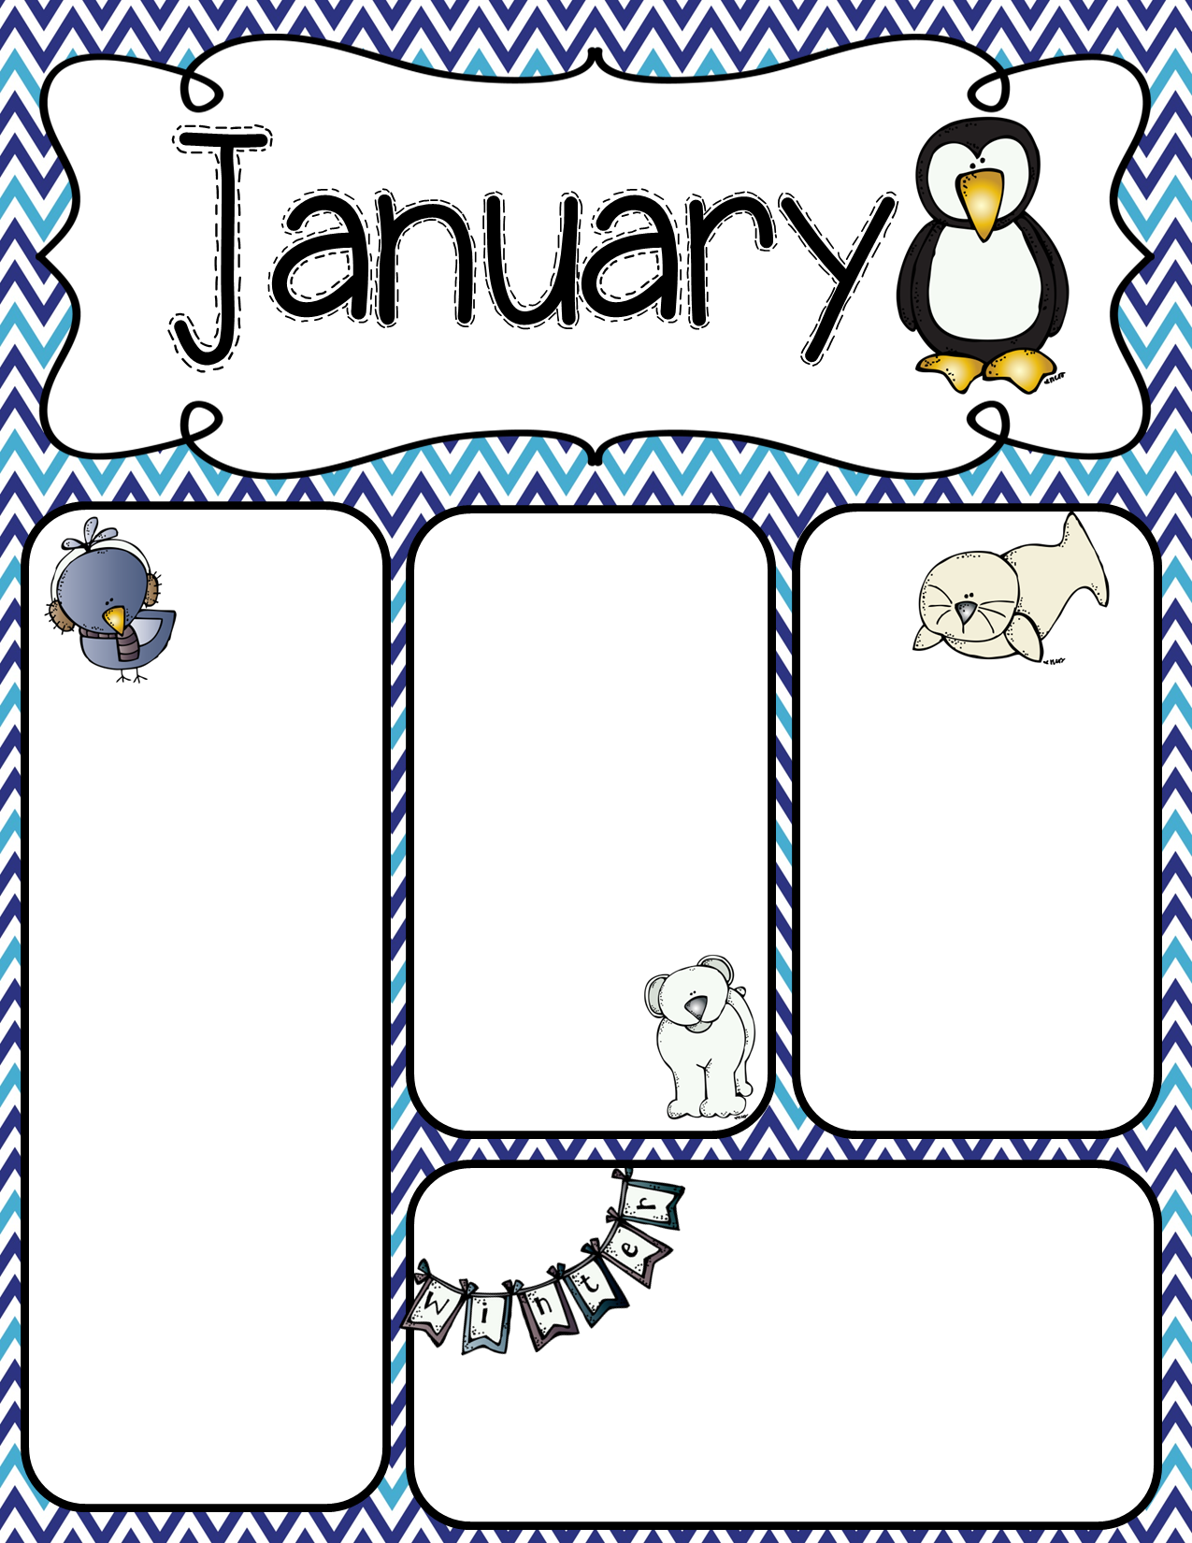
Week of Jan. 23-27, 2023
Math: Module 5: Fractions
Monday – EOM 4 Test
Tuesday –Lesson 1
Wednesday – Lesson 2 Thursday – – Lesson 3 Friday – Lesson 4
This week (A), students in 3-04 will have Ms. Darnell for math and science in the morning, then switch to Mrs. Dollar for ELA after lunch.
Students 3-03 will have Mrs. Dollar for ELA and social studies, then switch to math in the afternoon with Ms. Darnell
Important Dates!
Wed., Jan. 25th is Ms. Darnell’s birthday!
Thur., Jan. 26th – Spring Pictures & Spaghetti Night!
Tues., Jan. 31st is 3rd Grade Literacy Commitment Meeting between 3:30-6:30. More information will come home in Wednesday folders with times. This will be in place of P/T conference on Feb. 16th. 3rd Grade teachers will NOT be having P/T Conference on Feb. 16th.
Feb. 1-2 Good Mornings with Grown-ups!
Homework –
Math – Unit 4 Fractions Homework Packet
Science Unit of Study: 3-04 Weather Tools
Grade Improvement: Papers will come home Wednesday, as usual. Please return any grade improvements by Monday, Feb. 7th.
Bring CHARGED devices daily..
We are using them every day!!
UNIFORMS: Jackets worn inside the classrooms must be a SOLID color: white, khaki, grey, black, red, or navy.

Slide 11
Week of Jan. 17-20, 2023
Math: Module 4: Multiplication & Area
Tuesday –Lesson 12/13
Wednesday – Lesson 13
Thursday – Lesson 14
Friday – Mock CFA/Module 4 Review
EOM 4 Test on
Monday, Jan., 23
Homework –
Math – Unit 4 Area
Practice last week’s lessons 10, 12, 13, & 14 Due Friday
Grade Improvement: Papers will come home Wednesday, as usual. Please return any grade improvements by the following Monday.
This week, students
in 3-03 will have Ms. Darnell for math and science in the morning then switch to Mrs. Dollar for ELA after lunch.
Students 3-04 will have Mrs. Dollar for ELA and social studies, then switch to math in the afternoon with Ms. Darnell
Wed., Jan. 18 – Report Cards for the 2nd 9 Weeks go LIVE in Power School
Fri., Jan 20 @5:15 Skate Night - Cordova Skate Center
Wed., Jan. 25th is Ms. Darnell’s birthday!
Thur., Jan. 26th – Spring Pictures & Spaghetti Night!
Bring CHARGED devices daily..
We are using them every day!!
UNIFORMS: Jackets worn inside the classrooms must be a SOLID color: white, khaki, grey, black, red, or navy.

Slide 12
Week of Jan. 9-13, 2023
This week, students
in 3-04 will have
Ms. Darnell for
math and science
in the morning
then switch to Mrs. Dollar for ELA after lunch.
Students 3-03 will have Mrs. Dollar for ELA and social studies, then switch to math in the afternoon with Ms. Darnell
Important Dates!
Mon., Jan 16 – No School
(MLK.Jr. Day)
Wed., Jan. 18 – Report Cards for the 2nd 9 Weeks go LIVE in Power School
Fri., Jan 20 @5:15 Skate Night - Cordova Skate
Center
Thur., Jan. 26th – Spring Pictures & Spaghetti Night!
Homework –
Math –
Homework
Packet due
Friday
Science – 3-03 Hmwk water cycle diagram; completed IN CLASS.
Science 3-03 – weather water cycle, clouds; Test Friday – open notes
Wed., Jan. 25th is Ms. Darnell’s B-Day!
Math: Module 4: Multiplication & Area
Monday – Lesson 9
Tuesday –Lessons 10
Wednesday – Lesson 11 (iReady Math Diagnostic during ELA Block)
Thursday – – Topic C; lessons 9-11 Review (Classwork Grade)
Friday – – Lesson 12
Bring CHARGED devices daily..
We are using them every day!!
UNIFORMS: Tops & Dresses: Red, White and Grey
Bottoms & Jumpers: Khaki, Navy,
or Black

Slide 13
Week of Jan. 3-6, 2023
This week, students
in 3-03 will have
Ms. Darnell for
math and science
in the morning
then switch to Mrs. Dollar for ELA after lunch.
Students 3-04 will have Mrs. Dollar for ELA and social studies, then switch to math in the afternoon with Ms. Darnell
Important Dates!
Mon., Jan 16 – No School
(MLK.Jr. Day)
Read-a-Thon – currently going on through Jan. 6th
Wed., Jan. 198 – Report Cards for the 2nd 9 Weeks go LIVE in Power School
Fri., Jan 20 @5:15 Skate Night - Cordova Skate
Center
Homework –
Math – NO
Homework this week!
Science – 3-04 Hmwk water cycle diagram; completed IN CLASS.
Science 3-04 – weather water cycle, clouds; Test Friday – open notes
Grade Improvement: Papers will come home Wednesday, as usual. Please return any grade improvements by the following Monday.
Math: Module 4: Multiplication & Area
Monday – No School
Tuesday –Lessons 6&
Wednesday – iReady Reading Diagnostic (yes, during math)
Thursday – – Lesson 8
Friday – – Mid-Module 4 Test
Bring CHARGED devices daily..
We are using them every day!!
UNIFORMS: Tops & Dresses: Red, White and Grey
Bottoms & Jumpers: Khaki, Navy,
or Black

Slide 14
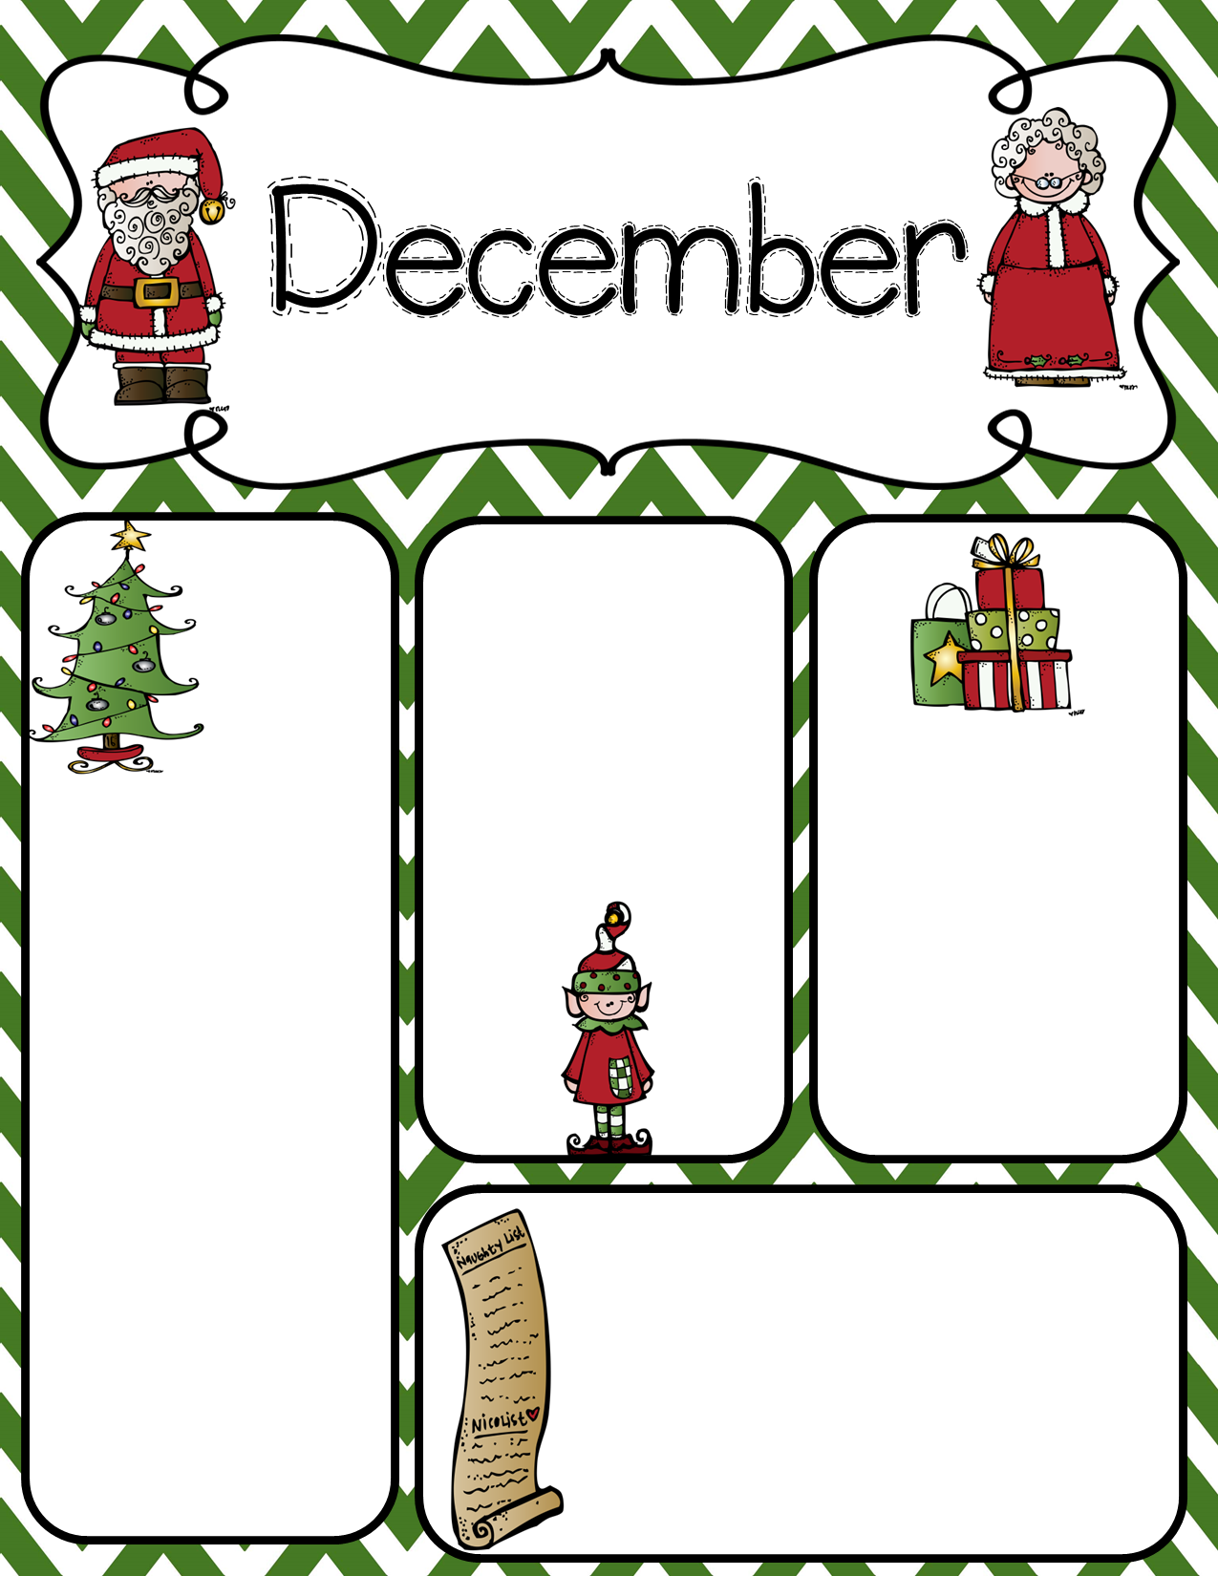
Week of Dec. 12-16, 2022
Math: Module 4 - Area
Monday – Lesson 4
Tuesday –Lesson 5
Wed – Lesson 6
Thur – Lesson 7
Friday –
Holiday Math
Activities. &
Class
Party
12:00 pm
Homework –
No Math or Science Homework. Please turn in any older homework packets for partial credit.
Grade Improvement: Please correct and return any grade improvement papers by Friday.
This week, students
in 3-04 will have Ms. Darnell for math and science in the morning then switch to Mrs. Dollar for ELA after lunch.
Students 3-03 will have Mrs. Dollar for ELA and social studies, then switch to math in the afternoon with Ms. Darnell
Spread some Holiday Cheer! (see p. 2 below)
On. Dec. 12 – Tree Topper Day
Tues., Dec. 13 – Grinch Day
Wed., Dec. 14 – Holiday Spirit - Favorite Season Colors
Thur., Dec. 15 –Pajama Day/
Fri., Dec 10 – Channel your Flannel
Bring CHARGED devices daily..
We are using them every day!!
(Including Friday!!)
UNIFORMS: Tops & Dresses: Red, White and Grey
Bottoms & Jumpers: Khaki, Navy,
or Black
Be on the look-out for Read-a-thon info coming soon!

Slide 15
Sharing gifts is a part of our holiday traditions. This year we are encouraging each student to bring small, inexpensive items to give to the other students in our class (1 item per child). I will provide a gift bag for each child, and they will have the opportunity to decorate their bag during class. Each day, several students will bring a small item to put in the gift bags. These should be inexpensive items like those you would purchase at the dollar store, Wal-mart, or Target’s dollar section. Some suggestions are pencils, erasers, stickers, party favors, mini puzzles etc. You may send generic treats for the whole class or you may choose to send different treats for boys & girls. Please look below and find your child’s assigned stocking stuffer date. We have 20 students total in our class: 9 girls and 11 boys. Please use the following schedule to send in your items. The students will receive their treat bags during our Winter party on December 16th.
The following schedule is based on
the 1st letter of your last name:
Dec. 12th – A-F
Dec. 13th – G-N
Dec. 14th – O-T
Dec. 15th – U-Z
Dec. 16th - Mrs. Darnell
Thank you and Happy Holidays,
Ms. Darnell
*this activity is completely optional

Slide 16
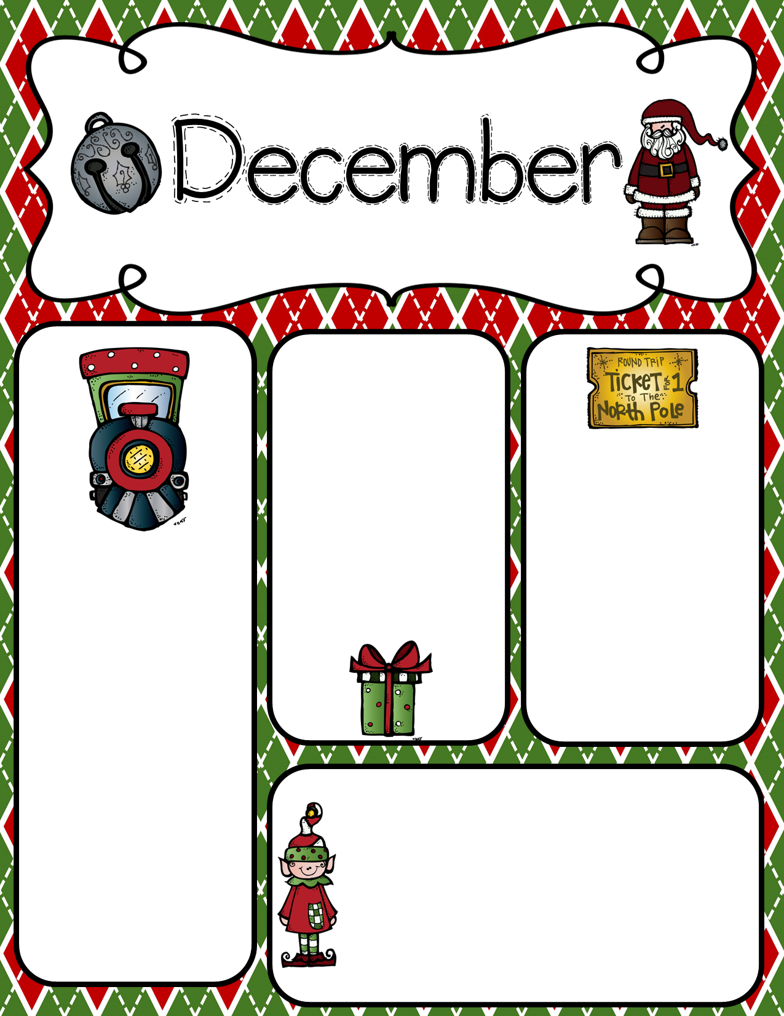
Week of Dec. 5-9, 2022
Math: Module 3 - Area
Monday – Math mastery Connect
Tuesday –Lesson 1
Wednesday Lesson 2
Thursday– Lesson 3
Friday – Lesson 4
Remember to bring in items for the
Memphis Food Bank
Homework –
Math packet –
Module 4;
Lessons 1-4
Science (3-03 Ms. Dollar’s class)
Energy and Circuits
Celebrate!
Please scroll down and read about our class activity to share gifts with one another during the holiday season!
This week, students in 3-03 will have Ms. Darnell for math and science in the morning then switch to Mrs. Dollar for ELA after lunch.
Students 3-04 will have Mrs. Dollar for ELA and social studies, then switch to math in the afternoon with Ms. Darnell
Spread some Holiday Cheer!
NEXT WEEK
Dec. 12 – Tree Topper Day
Tues., Dec. 13 – Grinch Day
Wed., Dec. 14 – Favorite holiday colors
Thur., Dec. 15 – PJ’s
Fri., Dec 116 – Channel your Flannel!
Bring CHARGED devices daily..
We are using them every day!!
UNIFORMS: Tops & Dresses: Red, White and Grey
Bottoms & Jumpers: Khaki, Navy,
or Black
Be on the look-out for Read-a-thon info coming soon!

Slide 17
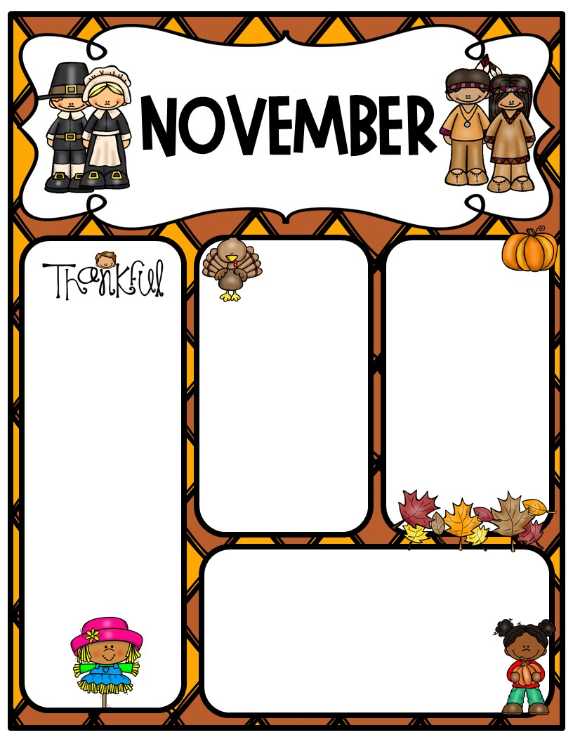
Week of Nov. 14-88, 2022
Newsletter
Homework –
Math packet/project – Multiplication Practice.
Do NOT cut apart. We will cut and glue in class on Friday.
Science (3-03 Ms. Dollar’s class)
Energy Lesson 2
This week, students in 3-03 will have Ms. Darnell for math and science in the morning then switch to Mrs. Dollar for ELA after lunch.
Students 3-04 will have Mrs. Dollar for ELA and social studies, then switch to math in the afternoon with Ms. Darnell
Important Dates:
Data Night – Tues., 11/15 @ 5:30 pm
Thanksgiving break is next week, Nov. 12-25th. Enjoy!!
Math: Module 3: Multiplication and Division with Units of 0, 1, 6-9, and multiples of 10.
Monday – Lesson 6
Tuesday –Lesson 7
Wednesday – Lesson 8
Thursday – Lesson 9
Friday –Mid-Module 3 Test
Bring CHARGED devices daily..
We are using them every day!!
UNIFORMS: Tops & Dresses: Red, White and Grey
Bottoms & Jumpers: Khaki, Navy,
or Black
Jackets/sweaters to wear indoors must be a
SOLID uniform color.

Slide 18
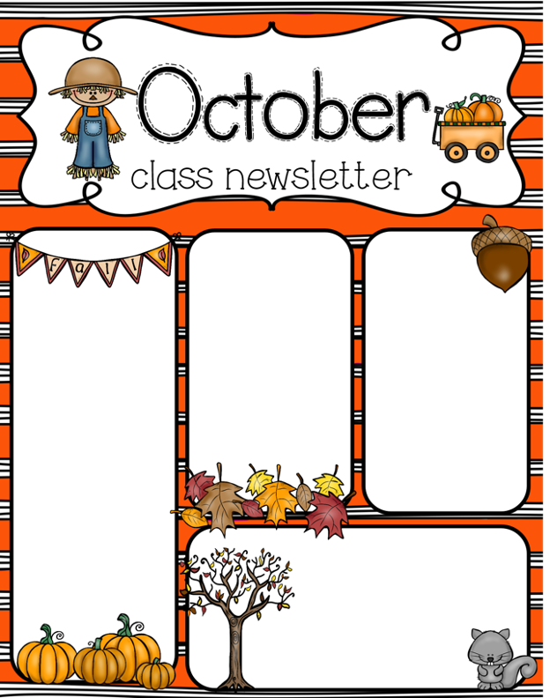
Week of Oct. 24-28, 2022
Math: Module 2
Properties of Multiplication and Division and Solving Problems with Units 2-5 and 10.
Monday – Lesson 17
Tuesday - Lesson 18
Wednesday - Lesson 19
Thursday – Lessons 20/21
Friday – End of Mod 2 Assessment
Tested skills: addition & subtraction with regrouping, rounding, telling time, and multi-step word problems
This is Week A:
3-03 will have math and science in the morning; ELA in the afternoon. Mid Module 2 Math Test is this Monday, Oct. 24th.
3-04 will have math in the afternoon. Mid Module 2 Math Test is this Tuesday, Oct. 25th.
Math Homework - packet due Friday.
Science (3-03 Mrs. Darnell’s class)
Force & Motion, Types of Energy, & Heat
Upcoming Dates:
Oct. 24-28 Red Ribbon Week
Mon – Sunglasses Tues – Hat Day
Wed – Crazy Socks Thur – Wear Red
Fri – Favorite Team Shirt
Monday, Oct. 31 – 3rd Grade Field Trip to Botanic Garden
Nov. 8 Election Day (no school)
Nov. 10 – 3rd grade Veteran’s Day Program
Nov. 11 – Veteran’s Day (no school)

Slide 19
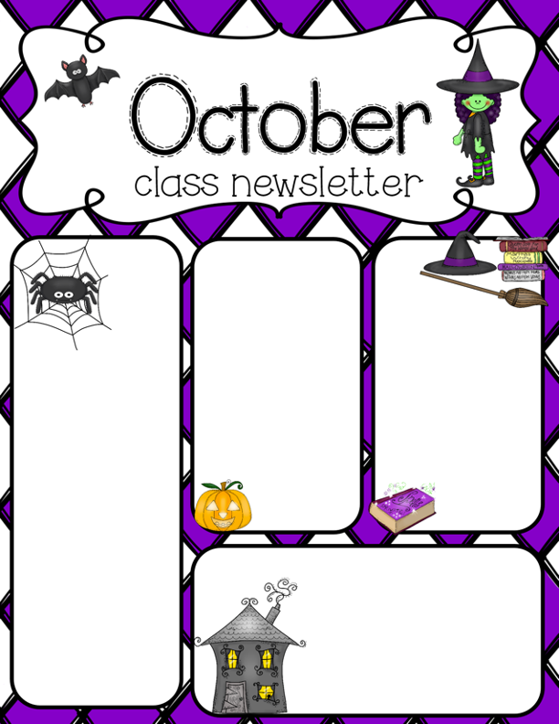
Week of Oct. 17-21, 2022
Math: Module 2
Properties of Multiplication and Division and Solving Problems with Units 2-5 and 10.
Monday – Lessons 8 & 10 measurement word problems
Tuesday - Lessons 12-14 – Rounding to 10s and 100s
Wednesday – Lessons 15 & 16 Addition w/regrouping
Thursday – Lesson 17 Estimate by rounding
Friday – Mid-Module 2 Test
Homework - Math packet due Friday
Science (3-03 Ms. Darnell’s class)
Energy
Open Book/Notes Quiz Friday
Homework - Converting Energy to Motion/Waves and Currents
This week, students in 3-03 will have Ms. Darnell for math and science in the morning then switch to Mrs. Dollar for ELA after lunch.
Students 3-04 will have Mrs. Dollar for ELA and social studies, then switch to math in the afternoon with Ms. Darnell
Important Dates:
Tues 10/18 Good Mornings w/Grown Ups (A-M)
Wed 10/19 Good Mornings w/Grown Ups (N-Z)
Thur 10/20 Picture Makeup Day
10/21 Trunk or Treat!! 5:30 pm
Bring CHARGED devices daily.. We are using them every day!!
Jeans: Students may wear jeans on Fridays if they are present all week without any tardies, and follow uniform guideline all week. Students must wear a uniform shirt with jeans. No rips in jeans, please.

Slide 20
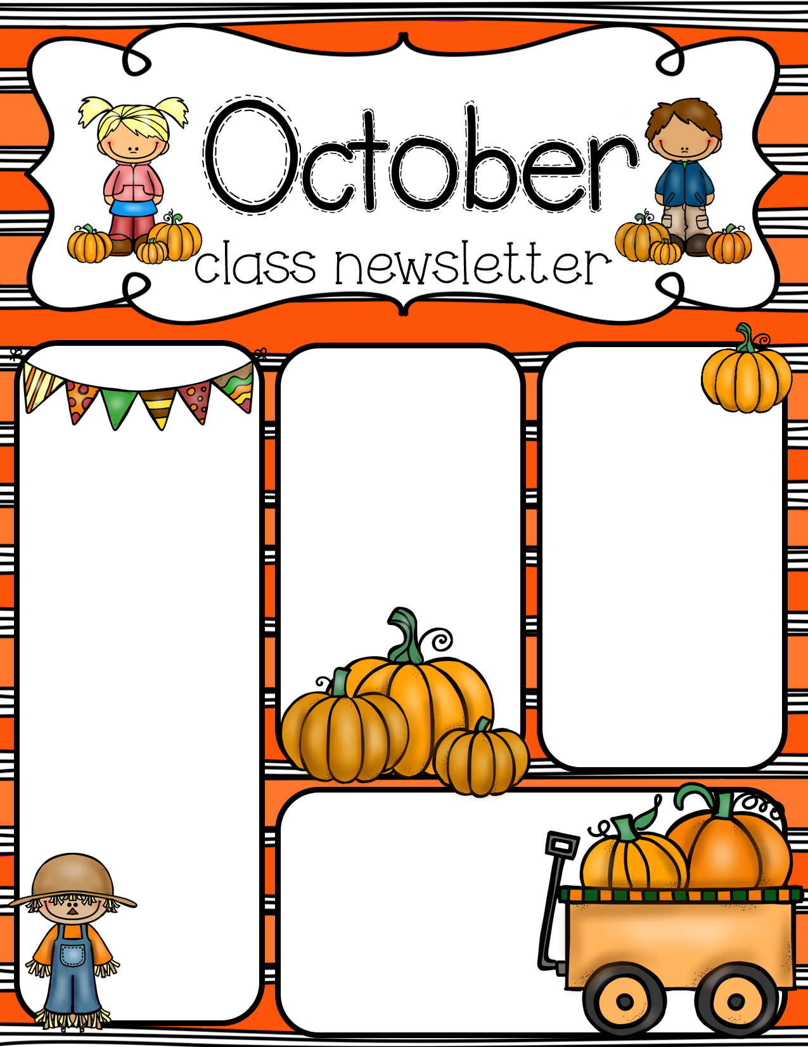
Week of Oct. 3-7, 2022
Homework:
Math: Math Scarecrow Project
Directions and materials will be sent home Monday. This DOES count as a project grade for the 9-weeks.
Students may turn them in early throughout the week.
.
Science
Unit 1 Lesson 2 cont. –
Lesson 3:
Chemical and
Physical Changes
Quiz on Wednesday for both classes.
Math: Module 2 – Place Value and Problem Solving with Units of Measure
Monday – Lessons 2 & 3 Telling Time
Tuesday – Lessons 4 & 5 Elapsed Time
Wednesday – Lessons 6 & 7 Measuring g to kg
Thursday – Lessons 9 & 10 Measuring volume w/mL and L
Friday – Lessons 8 & 11 Measurement Word Problems
Click here for Mrs. Dollar’s Class Website
Bring CHARGED devices daily.. We will begin using them every day!!
WATER BOTTLES: Please bring a refillable water bottle each day.
Important Dates:
9/29-10/07 - Book Fair
Oct. 10-14 – Fall Break
10/06 – Family Reading Night
10/21 – Trunk or Treat

Slide 21
Week of Sept. 26-30, 2022
Science
Unit 1 Lesson 2 cont. –
Lesson 3:
Chemical and
Physical Changes
Quiz on Friday.
Homework:
Math: packets are due on Friday. Students may turn them in early throughout the week.
Science:
Science homework is one
page. It is also due on Friday.
Math: Module 1 - Properties of Multiplication and Division and Solving Problems with Units 2-5 and 10.
Monday – Lessons 18/19
Tuesday – Lessons 20/21
Wednesday - Module 1 Assessment
Thursday – Module 2 Lesson 1
Friday – Module 2 Lesson 2
Click here for Mrs. Dollar’s Class Website
Bring CHARGED devices daily.. We will begin using them every day!!
WATER BOTTLES: Please bring a refillable water bottle each day.
Important Dates:
9/28 School Picture Day
9/29-10/07 - Book Fair
10/06 – Family Reading Night
10/21 – Trunk or Treat

Slide 22
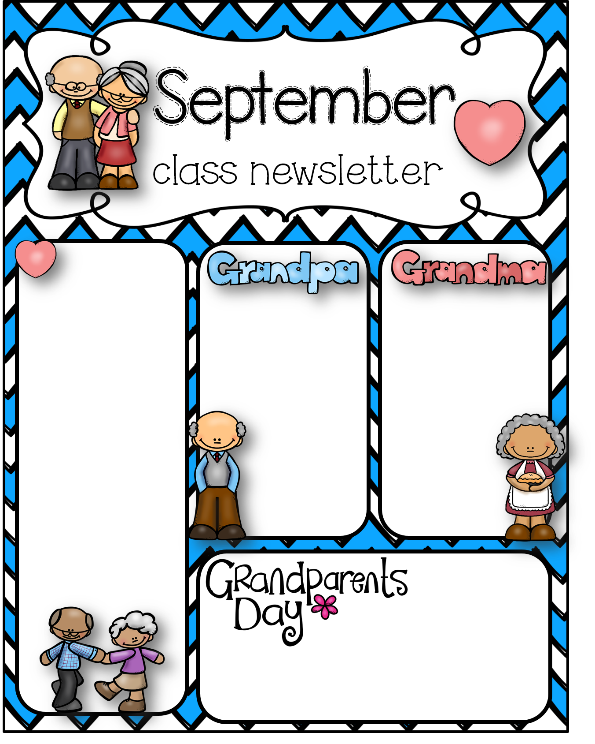
Math: Module 1 - Properties of Multiplication and Division and Solving Problems with Units 2-5 and 10.
Monday – Lesson 15 – Relate arrays to tape diagrams to model the commutative property of multiplication.
Tuesday – Lesson 16 – Use the distributive property as a strategy to find related multiplication facts.
Wednesday - Lesson 17 – Model the relationship between multiplication and division.
Thursday – Topics D & E Quiz – Lessons 11-17
Friday – Lessons 18/19 – Apply the distributive property to decompose units.
Homework:
Math: packets are due on Friday. Students may turn them in early throughout the week.
Science: 3-04
Darnell’s class
Science homework is one
page. It is also due
Friday.
Science (3-04 – Ms. Darnell’s Homeroom)
Unit 1 Lesson 2 cont. – Properties of States of Matter
Quiz Wednesday, Sept. 14th – open notes (can use science journals we create in class)
Lesson 3:
Chemical and
Physical Changes
Quiz next week
Wednesday, Sept. 14, 2022
Lunch with your Grandparents!
Lunch for 3rd Grade is moved to 10:30 am on Wednesday only! This is the day scheduled for grandparents to come eat with your 3rd grader!

Slide 23
Week of Sept. 6-9, 2022
Math: Module 1 - Properties of Multiplication and Division and Solving Problems with Units 2-5 and 10.
Monday – No School
Tuesday – Lesson 11 – Model division as the unknown.
Wednesday –Lesson 12 & 13 – Interpret the quotient as the number of objects in each group using units of 2 and 3.
Thursday - Lesson 14 – Skip-count objects in models to build fluency with multiplication facts using units of 4.
Friday – Lesson 15 – Relate arrays to tape diagrams to model the commutative property of multiplication.
Science (3-03 – Ms. Dollar’s Homeroom)
Unit 1 Lesson 2 – Changes in States of Matter
Quiz Friday, Sept. 9th – open notes (can use science journals we create in class)
Homework:
Math: packets are due on Friday. Students may turn them in early throughout the week.
Science: Science homework is one page. It is also due Friday.
Parent/Teacher Conferences
We will send out a link through Sign-up Genius for Parent Teacher Conferences. We will first send the link to parents with whom we would like to meet, then if spots are still available, we will send it to all parents.
Uniform Reminders:
Shirts – red, white, or grey
Bottoms – navy, black, or khaki
Inside Jackets or sweaters – any SOLID uniform color (no large logos)
Bring CHARGED devices daily.. We will begin using them every day!!
WATER BOTTLES: Please bring a refillable water bottle each day.
Important Dates:
9/08 – Parent/Teacher Conferences 4-7pm
9/14 Grandparents Day Lunch for 3rd
9/20 Watch Dogs Pizza/Mom’s Night Out
9/23 Skate Night
9/28 School Picture Day

Slide 24
August
Week of Aug. 29-Sept. 2, 2022
Sign-up Genius
We need items for some demonstrations and experiments. Please click the link below and donate any items you can. This will provide enough for both classes. Thank you!
https://www.signupgenius.com/go/20F0B49A9A62EA6FA7-matter
Science (3-03 – Ms. Dollar’s Homeroom)
Unit 1 Lesson 1 - Properties of Matter
Quiz next Friday, Sept. 9th
Homework:
Math: packets are due on Friday. Students may turn them in early throughout the week.
Science: Science homework is one page. It is also due Friday.
Math: Module 1 - Properties of Multiplication and Division and Solving Problems with Units 2-5 and 10.
Monday – Topics A & B Quiz
Tuesday – Lessons 7 & 8
Wednesday –Lesson 9
Thursday - Lesson 10 Friday – Mid Module 1 Assessment
Important Dates:
9/01: 901 Day! Represent the 901 by wearing U of M, Tiger, Grizzly, or Redbirds shirt. Uniform bottoms must be worn.
9/08 – Parent/Teacher Conferences 4-7pm
9/14 Grandparents Day Lunch for 3rd
9/20 Watch Dogs Pizza/Mom’s Night Out
9/23 Skate Night
9/28 School Picture Day
Bring CHARGED devices daily.. We will begin using them every day!!
WATER BOTTLES: Please bring a refillable water bottle each day.
Uniform Reminders:
Shirts – red, white, or grey
Bottoms – navy, black, or khaki
Inside Jackets or sweaters – any SOLID uniform color (no large logos)

Slide 25
Week of Aug. 22-26, 2022
Math: Module 1 - Properties of Multiplication and Division and Solving Problems with Units 2-5 and 10.
Monday – Lessons 2 & 3 Review
Tuesday – Lessons 4 & 5
Wednesday –Lesson 6
Thursday - Lesson 6 - Interpret the unknown in division using the array model
Friday – Review
Next Monday – Topics A & B Quiz (Test Grade)
Science (3-04 – Ms. Darnell’s Homeroom)
Unit 1 Lesson 1 - Properties of Matter
Homework:
Math: packets are due on Friday. Students may turn them in early throughout the week.
Science: Science homework is one page. It is also due Friday.
Parents,
Thank you for your understanding and patience these first few weeks of school as I have had some family emergencies. I will be absent this Friday as well.
Bring CHARGED devices daily.. We will begin using them every day!!
WATER BOTTLES: Please bring a refillable water bottle each day.
Uniform Reminders:
Shirts – red, white, or grey
Bottoms – navy, black, or khaki
Inside Jackets or sweaters – any SOLID uniform color (no large logos)

Slide 26
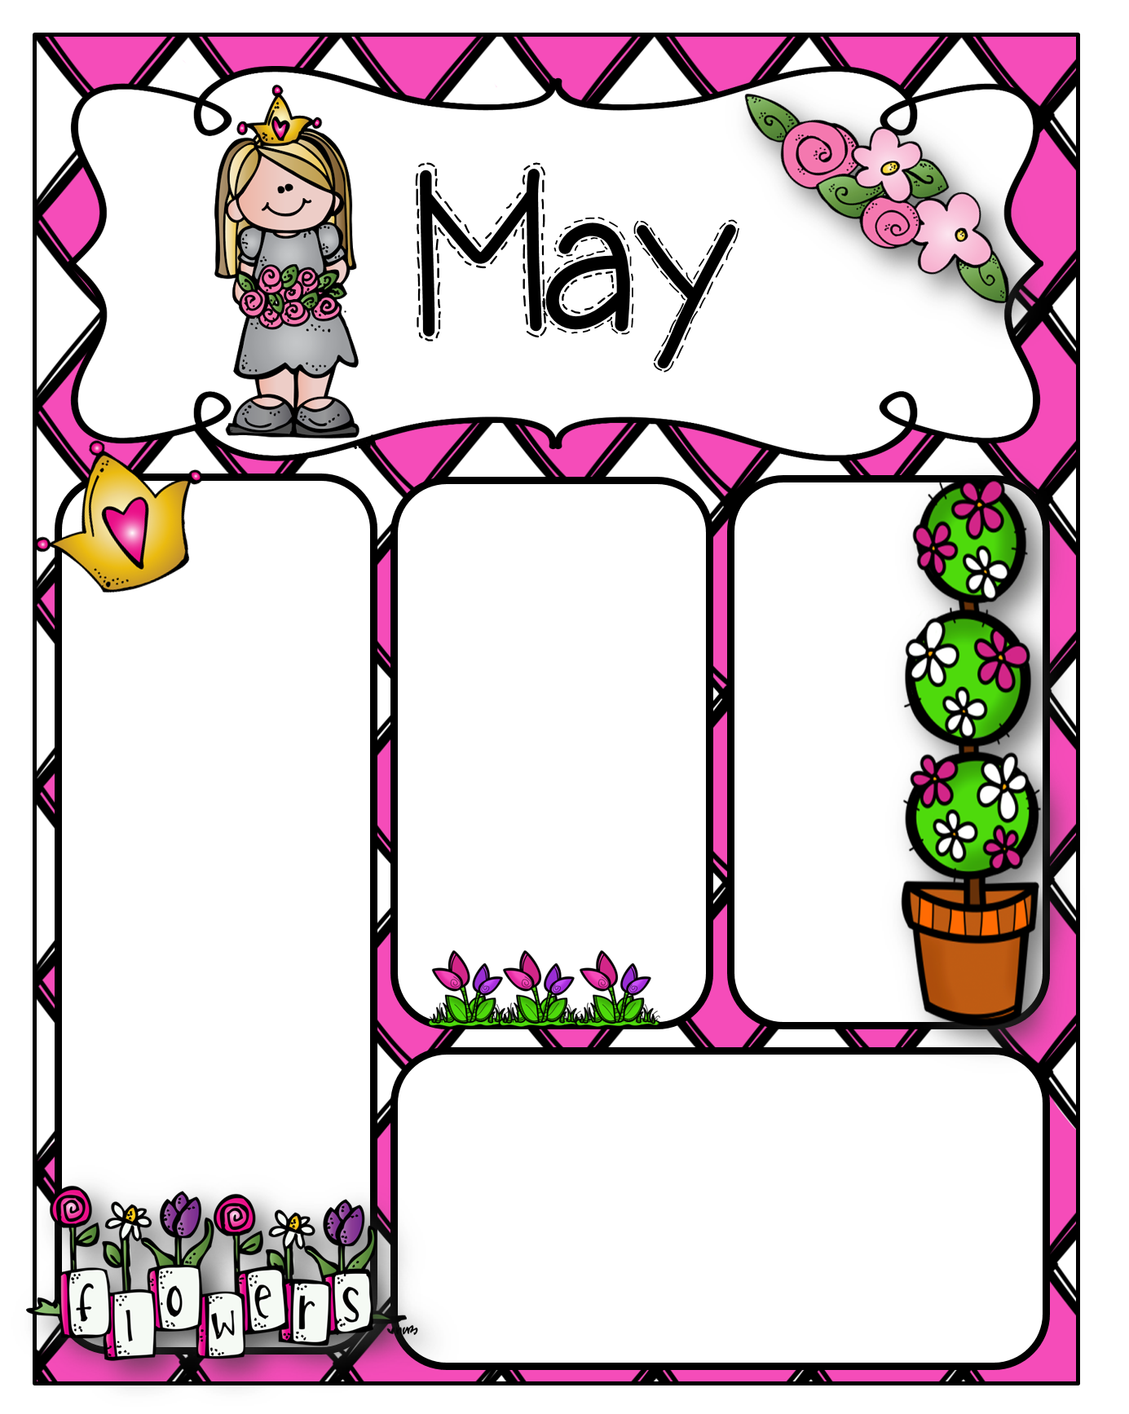
Add
Text
here
Add
Text
here
Add
Text
here
Add
Text
here

Slide 27
Add
Text
here
Add
Text
here
Add
Text
here
Add
Text
here

Slide 28
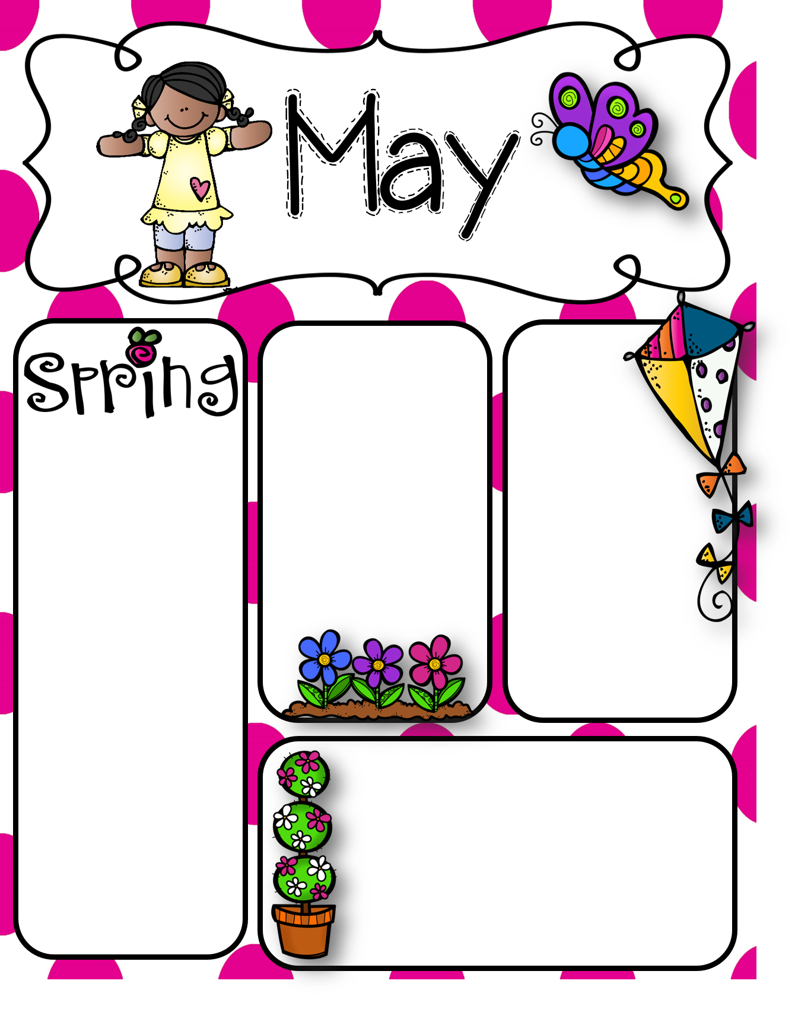
Add
Text
here
Add
Text
here
Add
Text
here
Add
Text
here

